Slide 1

Cloud Native Applications
Advancing Spring Boot with Actuator

Slide 2
Spring Boot Actuator 2
Additional Features to help you monitor and manage your application in production
<dependency>
<groupId>org.springframework.boot</groupId>
<artifactId>spring-boot-starter-actuator</artifactId>
</dependency>

Slide 3
How to enable endpoints
Default exposed endpoints are /info and /health.
management.endpoints.web.exposure.include=*
management.endpoints.web.exposure.include=info,health,env
All endpoints are not secured by default.

Slide 7
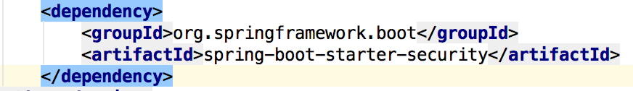
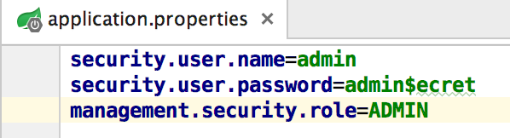
HTTP Access
Importing Spring Security Dependency
Setting required Authentication & Authorization Roles
Notes:
The management endpoints are secure even if the application endpoints are insecure.
Security events are transformed into AuditEvents and published to the AuditService.
The default user will have the ADMIN role as well as the USER role.

Slide 8
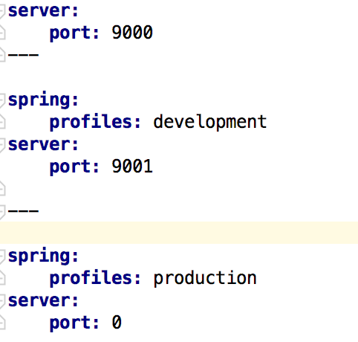


Profiles
YAML file can contain for several documents
Convenient to specify alternate configurations in the same file
Set the active profile
SPRING_PROFILES_ACTIVE=production
or
spring.profiles.active=production
Development profile
Production profile
Notes:
If one wants to set the active Spring profiles
The Spring Environment has an API for this, but normally one would set either a System.property, or an OS environment variable or it can be set in the application.properties (or application.yml) file
The YAML documents are merged in the order they are encountered (so later values override earlier ones)

Slide 9

Lab

